Slide 1
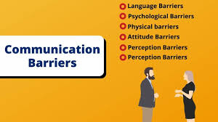
KIET GROUP OF INSTITUTIONS,GHAZIABAD BRIDGE GAP COURSE(Batch 1) BARRIERS TO COMMUNICATION By- NIPUN MITTAL (BTECH CSE)

Slide 2
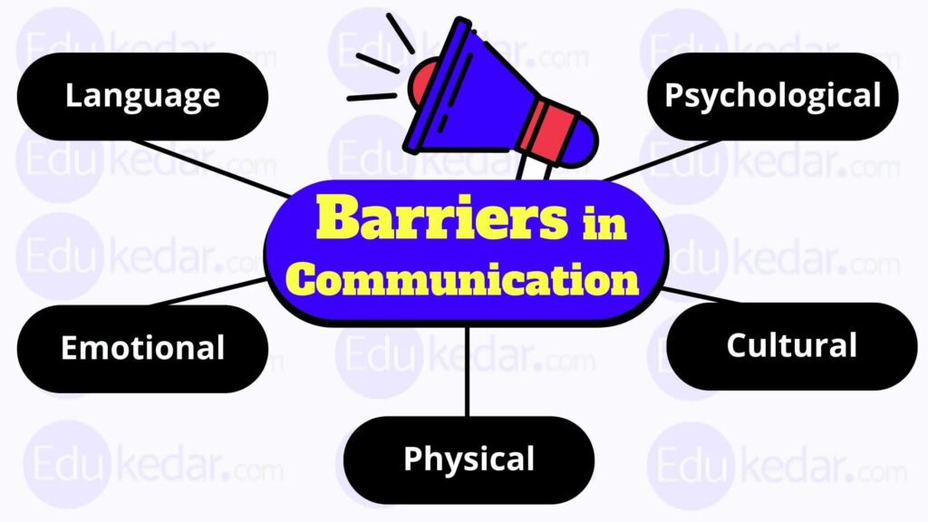
Introduction
Communication is a process by which information is exchanged between
individuals through a common system of symbols, signs or behavior.
A barrier to communication is anything that causes hinderance in the process of
getting and understanding messages that sends to
the other.
These include factors such as language differences,
noise, distractions, lack of clarity in message, cultural
differences, and more.
In this presentation, we will explore eight different
types of barriers to communication and their impact.

Slide 3
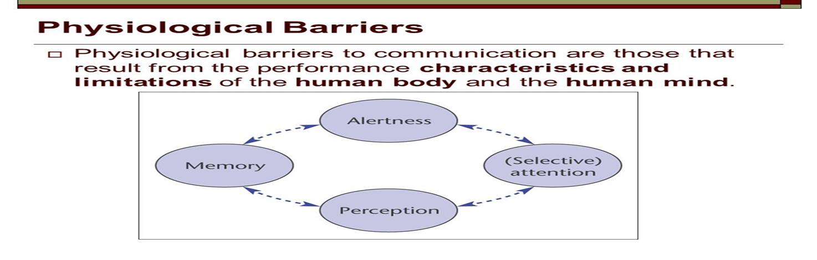
Physiological Barriers
Physiological barriers are related to person’s health and fitness.
It occurs due to physical disabilities like sensory
disfunction or any other physical disfunction.
Effective communication requires proper
functioning of senses in both sender and receiver.
Physiological barriers may result from individual’s personal discomfort, caused by ill-health, poor eye sight or hearing difficulties.

Slide 4
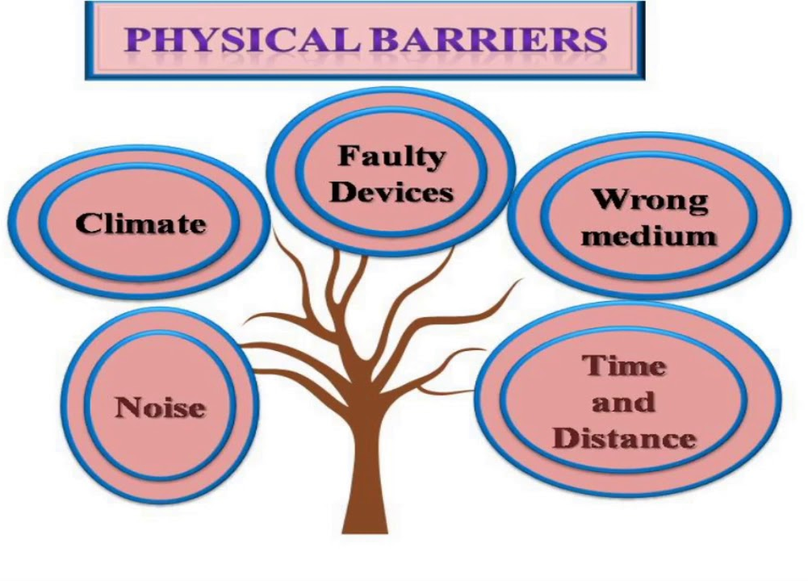
Physical Barriers
Physical barrier is the environmental and natural condition that act as a
barrier in sending message from sender to receiver.
Physical obstacles, like distance, noise, and poor
acoustics can hinder clear communication.
These barriers disrupt the transmission of information
and make it challenging to convey messages accurately.
Promoting open workspace design, using concise messages
and reducing noise are several measures to overcome physical barriers.

Slide 5
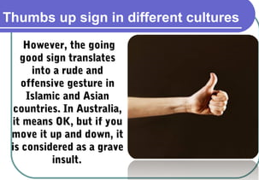
Cultural Barriers
Cultural Barriers to communication refers to the challenges
that arise from differences in cultural backgrounds.
These barriers can slow down the flow of information
and lead to misinterpretations, ultimately affecting
quality and efficiency of communication.
Cultural barriers in communication occurs mainly when communication
happens between two different cultural backgrounds.
Cultural difference awareness, being open minded, learning about each
other’s culture are various ways by which we can deal with cultural barriers.

Slide 6
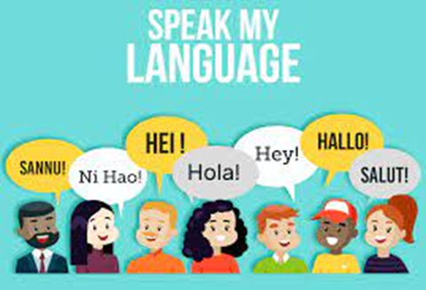
Language Barriers
Language barrier primarily occur when people speaking different
language are unable to understand one another.
Language barriers are most common communication
barriers which cause misunderstanding and misconceptions
between people.
Difference in language, regional accents, no clear speech
and bad word choice are main causes of language barriers.
Using simple language, speaking slowly and clearly, using visual aids
ways by which language barriers can be minimised.

Slide 7
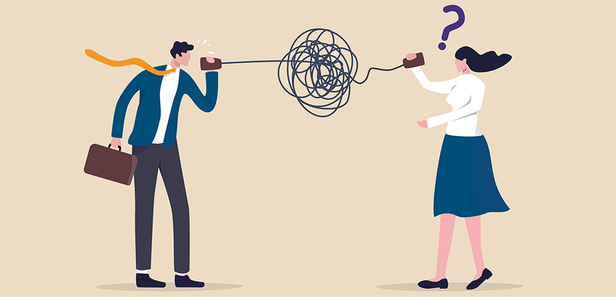
Gender Barriers
Gender barriers to communication refers to the limitations that arise in the
process of exchanging information between individuals of different genders.
These barriers emerge due to social expectations, cultural norms, and
stereotypes associated with gender roles.
It is important to note that gender barriers to
communication are not inborn to individuals but are
shaped by social and cultural influences.
Gender barriers to communication can be overcome by
challenging stereotypes and assumptions, developing empathy and
understanding and promoting open dialogue.

Slide 8
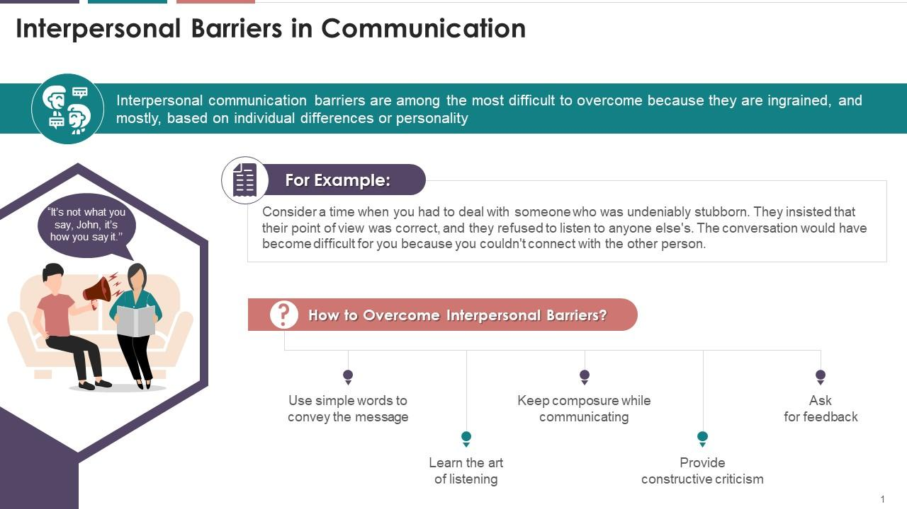
Interpersonal Barriers
Interpersonal barriers are negative patterns of behavior
that hinders you from communicating or discourage
others from communicating with you.
These barriers can arise due to various factors such as personal
differences, poor listening skills, cultural differences, and more.
Example-Consider you are talking to a person who is stubborn, he insisted that his point of view is correct, and he refused to listen anyone else. The conversation would become difficult for you because you couldn’t connect with the other person.

Slide 9
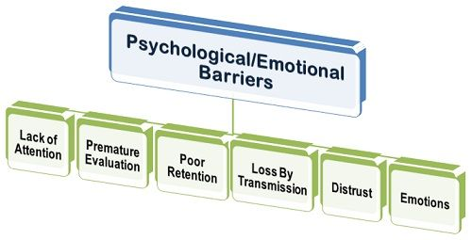
Psychological Barriers
Psychological barriers arises because of the psychological state of
sender and receiver. People’s physical and mental
conditions have a significant impact on
effectiveness of communication.
Situations such as inattentiveness, lack of sleep,
stress, mental illness, resistance to change and many
other factors interfere with good flow of communication.
For example, When an individual had a fight at home before attending a
meeting ,his mind will be preoccupied with stressful thoughts and will not
be able to concentrate on meeting.

Slide 10
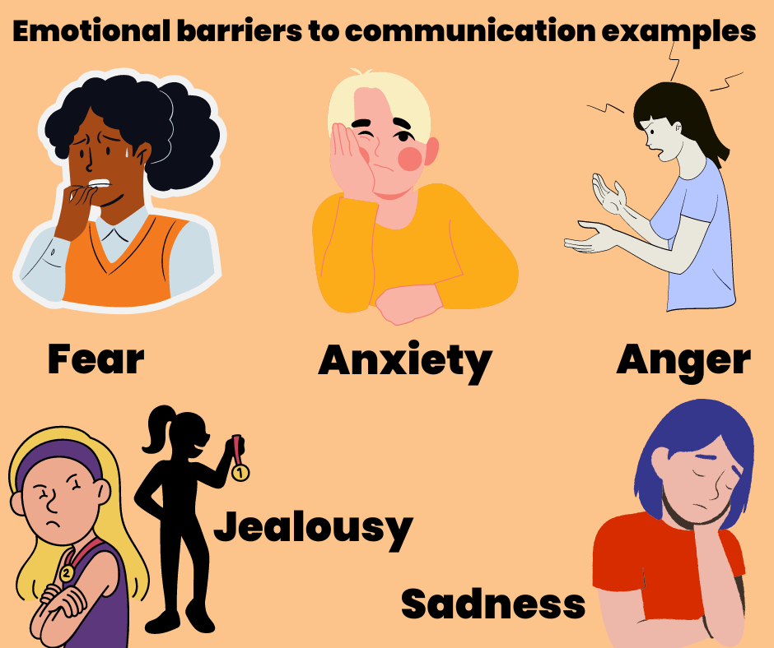
Emotional Barriers
Emotional barriers refers to the emotional obstacles that prevent the
productive interchange of information and emotions
among individuals.
Self-reflection and introspection, recognising common
emotional patterns and seeking feedback from trusted
individuals are some techniques to identify emotional barriers.
For example, Two colleagues are working on a project. One
has been consistently late in submitting his work, this results
in frustration for other.
Practicing self awareness, identifying our emotional triggers, not blaming
others, accepting imperfection are various ways by which one can overcome
emotional barriers.

Slide 11
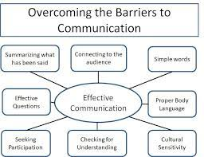
Conclusion
In conclusion, barriers of communication are like obstacles that can get in the way of people understanding each other.
These obstacles can be things like not understanding the
language, having too much noise around, or even having
different ideas and not been able to agree.
It’s important to be aware of these barriers and try to
overcome them so that messages can be shared clearly and effectively.
When we work to remove these barriers, it helps us to communicate
better with each other.

Slide 12


